Slide 1
Laurent Series (Exercise:7.3)

Slide 2
Objective
Finding Laurent series expansion of a complex valued function where Taylor series is not applicable
Methodologies
Binomial series expansion will be used to evaluate Laurent Series expansion

Slide 3

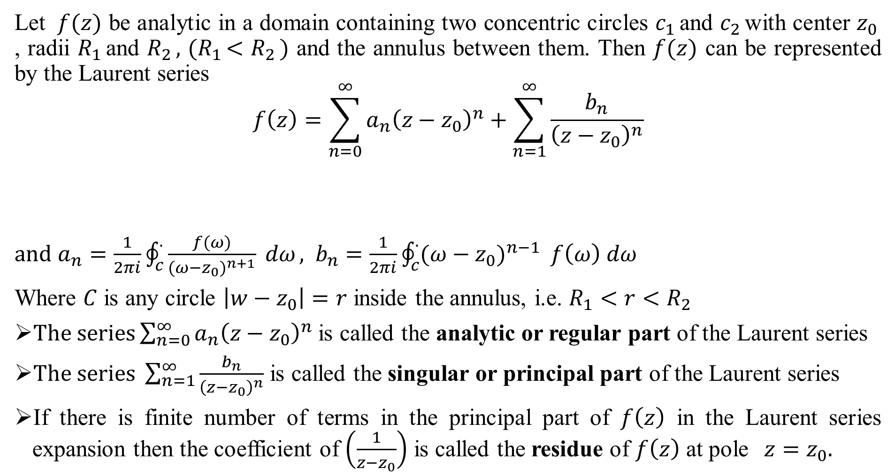


Laurent’s Theorem:
Let $f(z)$ be analytic in a domain containing two concentric circles $c_{1 }$and $c_{2 }$with center $z_{0 }$ , radii $R_{1 }$and $R_{2 },$ ${(R}_{1 }<R_{2 })$ and the annulus between them. Then $f(z)$ can be represented by the Laurent series
$$f\left(z\right)=\sum_{n=0}^{∞}{a_{n}{\left(z−z_{0}\right)}^{n}}+\sum_{n=1}^{∞}{\frac{b_{n}}{{\left(z−z_{0}\right)}^{n}}}$$
$and$ ${a_{n}=\frac{1}{2πi}\oint_{c}^{.}{\frac{f(ω)}{{(ω−z_{0})}^{n+1}}} dω}_{ }, { b}_{n}=\frac{1}{2πi}\oint_{c}^{.}{{(ω−z_{0})}^{n−1}} f\left(ω\right) dω$
Where $C$ is any circle $\left|w−z_{0}\right|=r$ inside the annulus, i.e. $R_{1}<r<R_{2}$
$The series\sum_{n=0}^{∞}{a_{n}{\left(z−z_{0}\right)}^{n}}$is called the analytic or regular part of the Laurent series
$The series \sum_{n=1}^{∞}{\frac{b_{n}}{{\left(z−z_{0}\right)}^{n}}}$ is called the singular or principal part of the Laurent series
If there is finite number of terms in the principal part of $f\left(z\right)$ in the Laurent series expansion then the coefficient of $\left(\frac{1}{z−z_{0}}\right)$ is called the residue of $f\left(z\right)$ at pole$z=z_{0}.$
Im {z}
O
$$R_{2}$$
$$z_{0}$$
$$R_{1}$$
Re {z}

Slide 4

**The integral formulas are not a practical way of computing the Laurent coefficients. Instead we use various algebraic tricks. Often we don’t really need all the coefficients. We will discuss a technique to compute those that we do need.
Binomial series expansion:
${\left(1+x\right)}^{n}=1+nx+\frac{n\left(n−1\right)}{2!}x^{2}$+ $\frac{n\left(n−1\right)\left(n−2\right)}{3!}x^{3}$+… converges for $\left|x\right|<1$
${\left(1+x\right)}^{−1}=1−x+x^{2}−x^{3}+$… converges for $\left|x\right|<1$
${\left(1−x\right)}^{−1}=1+x+x^{2}+x^{3}+$… converges for $\left|x\right|<1$
${\left(1+x\right)}^{−2}=1−2x+{3x}^{2}−4x^{3}+$… converges for $\left|x\right|<1$
${\left(1−x\right)}^{−2}=1+2x+{3x}^{2}+4x^{3}+$… converges for $\left|x\right|<1$

Slide 5
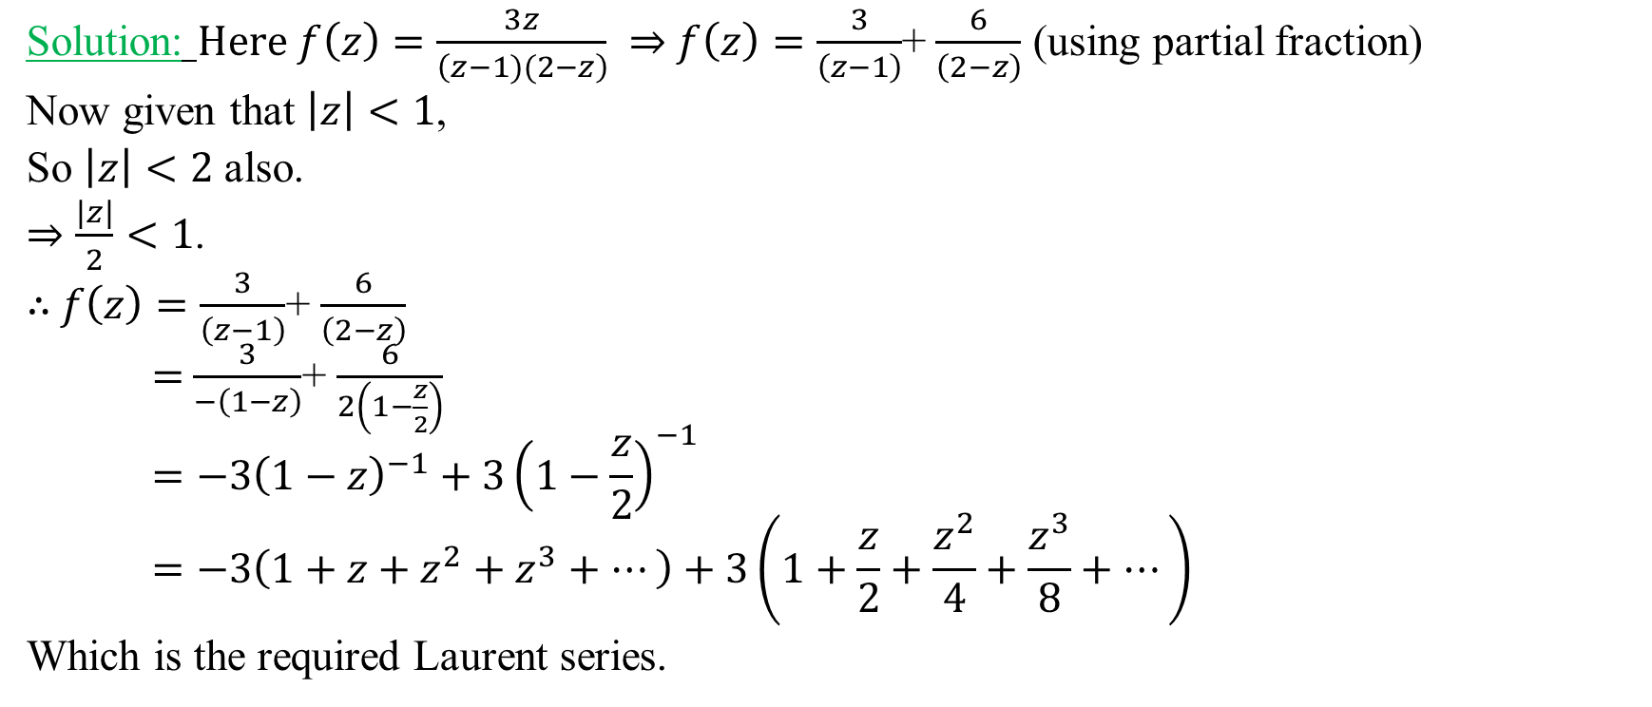
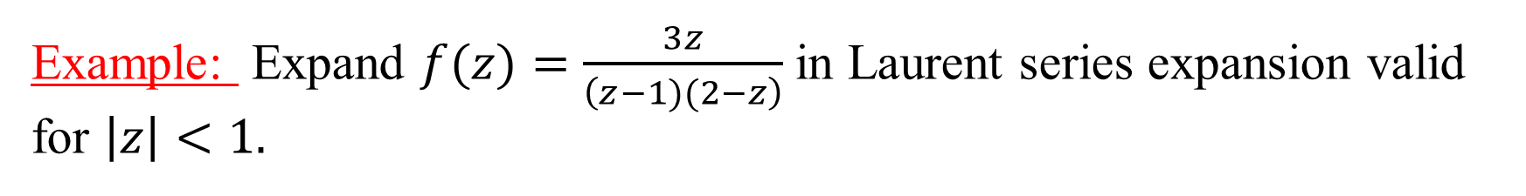

Example: Expand $f(z)=\frac{3z}{\left(z−1)(2−z\right)}$in Laurent series expansion valid for $\left|z\right|<1.$
Solution: $Here f\left(z\right)=\frac{3z}{\left(z−1)(2−z\right)} ⇒$ $f\left(z\right)=\frac{3}{\left(z−1\right)}$+ $\frac{6}{\left(2−z\right)}$ (using partial fraction)
Now given that $\left|z\right|<1$,
So $\left|z\right|<2$ also.
$⇒\frac{\left|z\right|}{2}<1$.
$∴$ $f\left(z\right)=\frac{3}{\left(z−1\right)}$+ $\frac{6}{\left(2−z\right)}$
$=$ $\frac{3}{−\left(1−z\right)}$+ $\frac{6}{2\left(1−\frac{z}{2}\right)}$
$$=−3{\left(1−z\right)}^{−1}+3{\left(1−\frac{z}{2}\right)}^{−1}$$
$$=−3\left(1+z+z^{2}+z^{3}+…\right)+3\left(1+\frac{z}{2}+\frac{z^{2}}{4}+\frac{z^{3}}{8}+…\right)$$
Which is the required Laurent series.
Im {z}
O
$$1$$
Re {z}

Slide 6
Example: Expand $f(z)=\frac{z}{\left(z+1)(3−z\right)}$in Laurent series expansion valid for $\left|z\right|>3.$
Solution: $Here f\left(z\right)=\frac{z}{\left(z+1)(3−z\right)} ⇒$ $f\left(z\right)=\frac{−1}{4\left(z+1\right)}$+ $\frac{3}{4\left(3−z\right)}$ (using partial fraction)
Now given that $\left|z\right|>3⇒\frac{\left|z\right|}{3}>1⇒\frac{3}{\left|z\right|}<1$,
Since $\left|z\right|>$3 hence $\left|z\right|>1⇒\frac{1}{\left|z\right|}<1$.
$∴$ $f\left(z\right)=\frac{−1}{4\left(z+1\right)}\text{+} \frac{3}{4\left(3−z\right)}$
$=$ $\frac{−1}{4z\left(1+\frac{1}{z}\right)}$+ $\frac{3}{−4z\left(1−\frac{3}{z}\right)}$
$$=−\frac{1}{4z}{\left(1+\frac{1}{z}\right)}^{−1}−\frac{3}{4z}{\left(1−\frac{3}{z}\right)}^{−1}$$
$$=−\frac{1}{4z}\left(1−\frac{1}{z}+\frac{1}{z^{2}}−\frac{1}{z^{3}}+…\right)−\frac{3}{4z}\left(1+\frac{3}{z}+\frac{9}{z^{2}}+\frac{27}{z^{3}}+…\right)$$
Which is the required Laurent series.
Im {z}
O
3
Re {z}

Slide 7
Example: Expand $f(z)=\frac{2z}{\left(z−1)(3−z\right)}$ valid for $1<\left|z\right|<3$.
Solution: $Here f\left(z\right)=\frac{2z}{\left(z−1)(3−z\right)} ⇒$ $f\left(z\right)=\frac{1}{\left(z−1\right)}$+ $\frac{3}{\left(3−z\right)}$ (using partial fraction)
Now given that $1<\left|z\right|<3⇒1<\left|z\right|⇒\frac{1}{\left|z\right|}<1 and$
$\left|z\right|<3$ $⇒\frac{\left|z\right|}{3}<1$.
$∴$ $f\left(z\right)=\frac{1}{\left(z−1\right)}\text{+} \frac{3}{\left(3−z\right)}$
$=$ $\frac{1}{z\left(1−\frac{1}{z}\right)}$+ $\frac{3}{3\left(1−\frac{z}{3}\right)}$
$$=\frac{1}{z}{\left(1−\frac{1}{z}\right)}^{−1}+{\left(1−\frac{z}{3}\right)}^{−1}$$
$$=\frac{1}{z}\left(1+\frac{1}{z}+\frac{1}{z^{2}}+\frac{1}{z^{3}}+…\right)+\left(1+\frac{z}{3}+\frac{z^{2}}{9}+\frac{z^{3}}{27}+…\right)$$
Which is the required Laurent series.
Im {z}
O
1
3
Re {z}

Slide 8

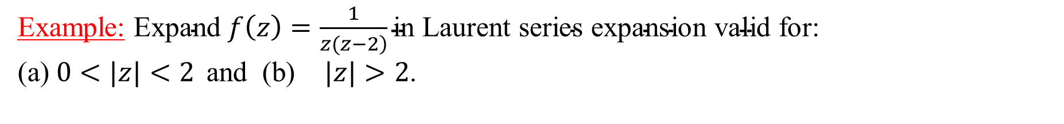
Example: $\text{Expand} f\left(z\right)=\frac{1}{\left.z(z−2\right)}\text{in} \text{Laurent} \text{series} \text{expansion} \text{valid} \text{for}$: $\text{(}\text{a}\text{)} 0<|z|<2 \text{and} \text{ (}\text{b}\text{)} |z|>2$.
Solution(a): $Here f\left(z\right)=\frac{z}{z\left(z−2\right)}$
Now given that $0<|z|<2 ⇒|z|<2 ⇒\frac{\left|z\right|}{2}<1$
$∴$ $f\left(z\right)=\frac{1}{z\left(z−2\right)}$
$=$ $\frac{1}{−2z\left(1−\frac{z}{2}\right)}$
$$=−\frac{1}{2z}{\left(1−\frac{z}{2}\right)}^{−1}$$
$$=−\frac{1}{2z}\left(1+\frac{z}{2}+\frac{z^{2}}{4}+\frac{z^{3}}{8}+…\right)$$
Which is the required Laurent series.
Im {z}
O
2
Re {z}
(a)

Slide 9

Solution(b):
Given that $\left|z\right|>2⇒\frac{\left|z\right|}{2}>1⇒\frac{2}{\left|z\right|}<1$
Now,
$$f\left(z\right)=\frac{1}{z\left(z−2\right)}$$
$$=\frac{1}{z^{2}\left(1−\frac{2}{z}\right)}$$
= $\frac{1}{z^{2}}{\left(1−\frac{2}{z}\right)}^{−1}$
$$=\frac{1}{z^{2}}\left(1+\frac{2}{z}+\frac{4}{z^{2}}+\frac{8}{z^{3}}+…\right)$$
Im {z}
O
2
Re {z}
(b)

Slide 10

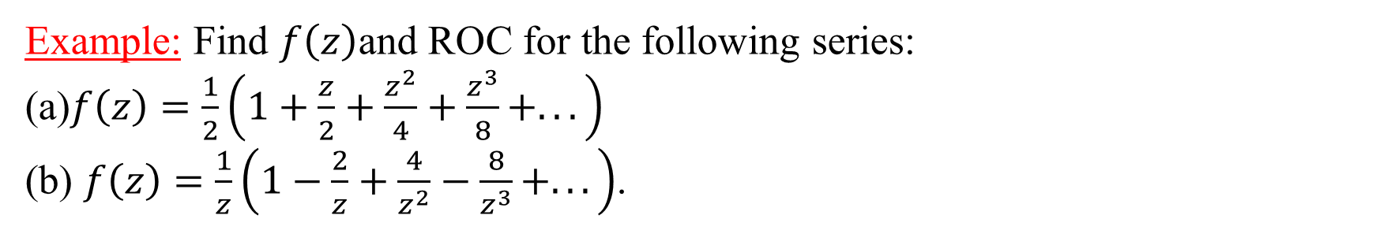
Example: Find $f\left(z\right)$and ROC for the following series: (a)$f\left(z\right)=\frac{1}{2}\left(1+\frac{z}{2}+\frac{z^{2}}{4}+\frac{z^{3}}{8}+...\right)$ (b) $f\left(z\right)=\frac{1}{z}\left(1−\frac{2}{z}+\frac{4}{z^{2}}−\frac{8}{z^{3}}+...\right)$.
Solution: (a) $f\left(z\right)=\frac{1}{2}\left(1+\frac{z}{2}+\frac{z^{2}}{4}+\frac{z^{3}}{8}+...\right)=\frac{1}{2}{\left(1−\frac{z}{2}\right)}^{−1}$; ROC: $\left|\frac{z}{2}\right|<1$
$f\left(z\right)=$ $\frac{1}{2\left(1−\frac{z}{2}\right)}$ ; ROC: $\left|z\right|<2$
= $\frac{1}{2\left(\frac{2−z}{2}\right)}$ ; ROC: $\left|z\right|<2$
= $\frac{1}{2−z}$ ; ROC: $\left|z\right|<2$.
Solution: (b) $f\left(z\right)=\frac{1}{z}\left(1−\frac{2}{z}+\frac{4}{z^{2}}−\frac{8}{z^{3}}+...\right)=\frac{1}{z}{\left(1+\frac{2}{z}\right)}^{−1}$; ROC: $\left|\frac{2}{z}\right|<1$
$f\left(z\right)=$ $\frac{1}{z\left(1+\frac{2}{z}\right)}$ ; ROC: $2<\left|z\right|$
= $\frac{1}{z\left(\frac{z+2}{z}\right)}$ ; ROC: $\left|z\right|>2$
= $\frac{1}{z+2}$ ; ROC: $\left|z\right|>2$.

Slide 11
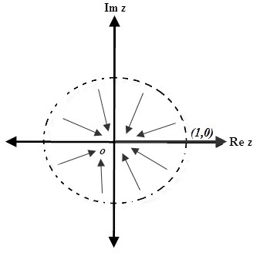
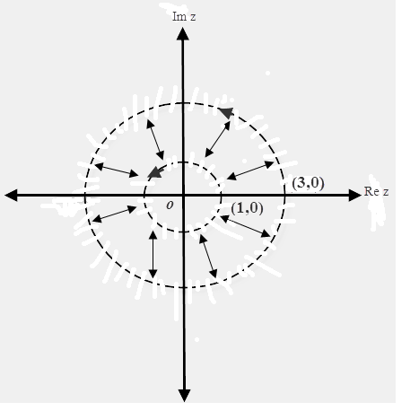

Exercises: Expand following functions in a Laurent series valid for indicated region of convergence(ROC):
$f\left(z\right)=\frac{1}{\left.z(z+3\right)} valid for \text{(}\text{a}\text{)} 0<|z|<\text{3} \text{and} \text{(}\text{b}\text{)} |z|>3$
$f(z)=\frac{5z}{\left(z+1)(z+2\right)}$ valid for $\text{(}\text{a}\text{)} 1<\left|z\right|<2\text{,}\text{ (}\text{b}\text{)} \left|z\right|>2 and \left(c\right) \left|z\right|<1.$
$f(z)=\frac{z}{\left(z−1)(3−z\right)}$ valid for following ROC’s:
$$(a)$$
$$(b)$$

Slide 12
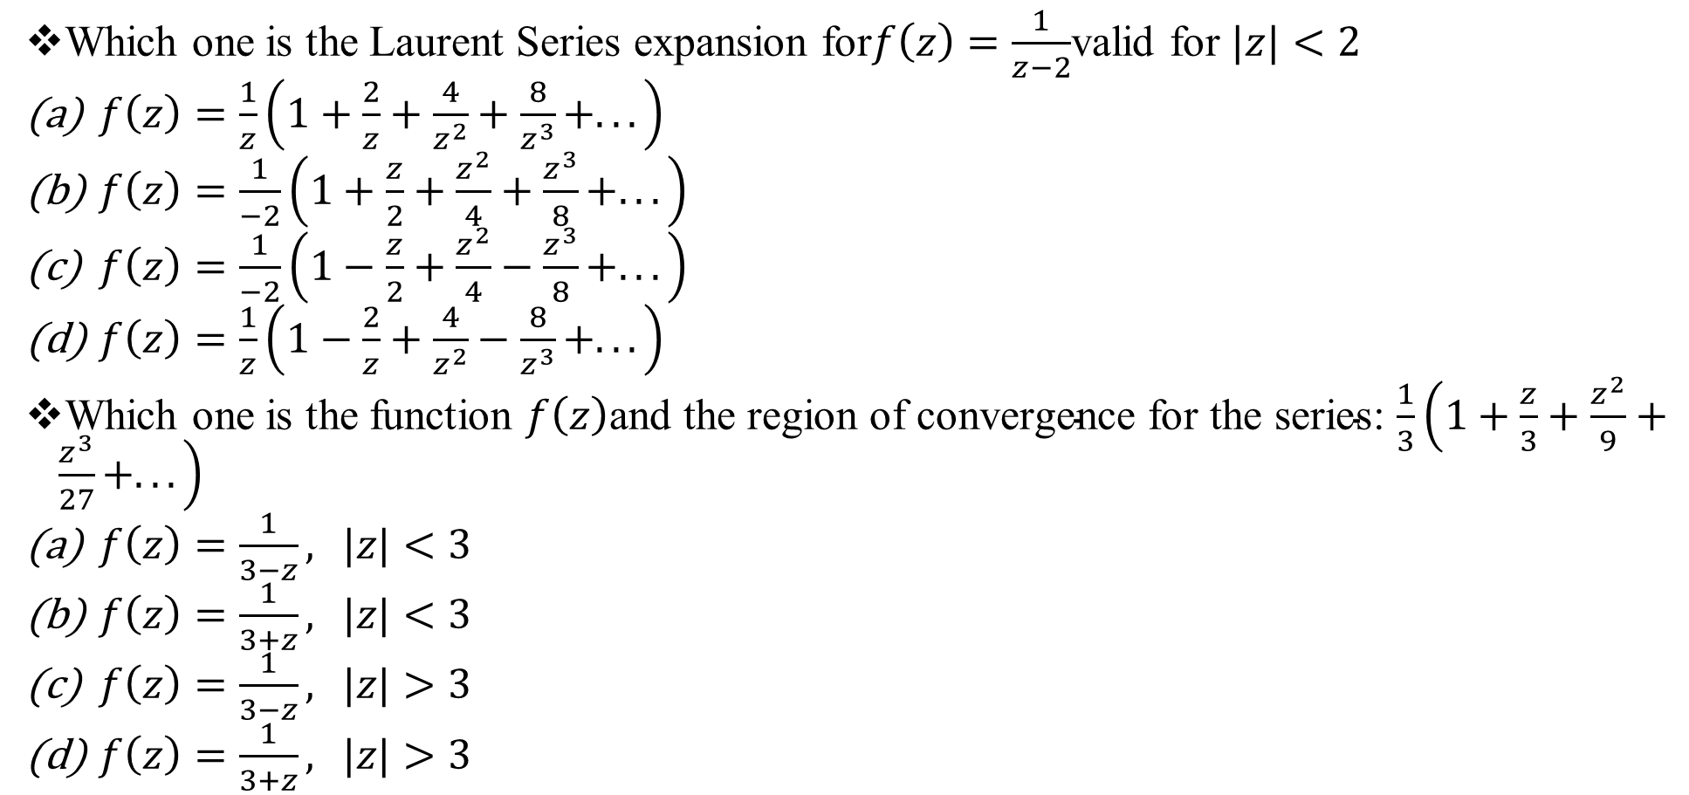
Sample MCQ:
Which one is the Laurent Series expansion for$f\left(z\right)=\frac{1}{z−2}$valid for $|z|<2$
$f\left(z\right)=\frac{1}{z}\left(1+\frac{2}{z}+\frac{4}{z^{2}}+\frac{8}{z^{3}}+...\right)$
$f\left(z\right)=\frac{1}{−2}\left(1+\frac{z}{2}+\frac{z^{2}}{4}+\frac{z^{3}}{8}+...\right)$
$f\left(z\right)=\frac{1}{−2}\left(1−\frac{z}{2}+\frac{z^{2}}{4}−\frac{z^{3}}{8}+...\right)$
$f\left(z\right)=\frac{1}{z}\left(1−\frac{2}{z}+\frac{4}{z^{2}}−\frac{8}{z^{3}}+...\right)$
Which one is the function $f\left(z\right)\text{and} \text{the} \text{region} \text{of} \text{convergence} \text{for} \text{the} \text{series}$: $\frac{1}{3}\left(1+\frac{z}{3}+\frac{z^{2}}{9}+\frac{z^{3}}{27}+...\right)$
$f\left(z\right)=\frac{1}{3−z}, |z|<3$
$f\left(z\right)=\frac{1}{3+z}, |z|<3$
$f\left(z\right)=\frac{1}{3−z}, |z|>3$
$f\left(z\right)=\frac{1}{3+z}, |z|>3$

Slide 13
Sample MCQ:
Which one is the Laurent Series expansion for : $f\left(z\right)=\frac{1}{z(z−2)}, 0<\left|z\right|<2.$
(a) $f\left(z\right)=−\frac{1}{2z}\left(1+\frac{z}{2}+\frac{z^{2}}{4}+\frac{Z^{3}}{8}+…\right)$
(b) $f\left(z\right)=−\frac{1}{2z}\left(1−\frac{z}{2}+\frac{z^{2}}{4}−\frac{Z^{3}}{8}+…\right)$
(c) $f\left(z\right)=\frac{1}{z^{2}}\left(1+\frac{2}{z}+\frac{4}{z^{2}}+\frac{8}{Z^{3}}+…\right)$
(d) $f\left(z\right)=\frac{1}{z^{2}}\left(1−\frac{2}{z}+\frac{4}{z^{2}}−\frac{8}{Z^{3}}+…\right)$
Which one is the Laurent Series expansion for $f\left(z\right)=\frac{1}{z−1}$ valid for $\left|z\right|>1$
$f\left(z\right)=\frac{1}{z}\left(1−\frac{1}{z}+\frac{1}{z^{2}}−\frac{1}{z^{3}}+...\right)$
$f\left(z\right)=−\left(1−z+z^{2}−z^{3}+...\right)$
$f\left(z\right)=\frac{1}{z}\left(1+\frac{1}{z}+\frac{1}{z^{2}}+\frac{1}{z^{3}}+...\right)$
$f\left(z\right)=−\left(1+z+z^{2}+z^{3}+...\right)$
Which one is the function$f(z)$ and the region of convergence for the series:
$$1−z+z^{2}−z^{3}+...$$
(a) $f\left(z\right)=\frac{1}{1−z}, |z|<1$ (b) $f\left(z\right)=\frac{1}{1+z}, |z|<1$ (c) $f\left(z\right)=\frac{1}{1+z}, |z|>1$ (d) $f\left(z\right)=\frac{1}{1−z}, |z|>1$.

